Slide 1
ML Design Pattern: Adversarial Learning
Internet Abuse & Spam

Slide 2
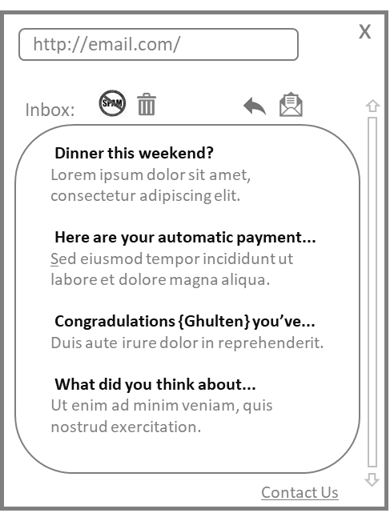
Example: Running an Internet Scale Email Service
Filter
100s of Millions
of messages per day
10s of Millions
of users per day
User Interface
Email Store
Junk Store
Email Senders
Email Service

Slide 3
What Abusers Want
Reasons for Abuse
Crime, espionage
For fun
To make money
Email Spam
Advertising
Phishing attacks
Distribute malware
Making Money with Abuse
Driving traffic
Compromising personal information
Compromising computers
Boosting content
Suppressing content
Stealing content

Slide 4
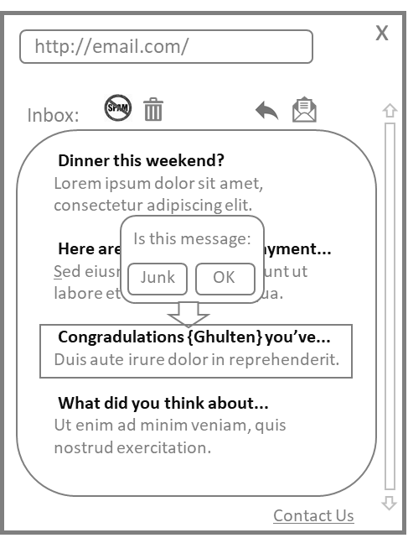
Closed Loop Approach to Abuse
Filter
New Spam Attack
Defeats Filter
Defeats Spam
Users Encounter
Over Time
Email Store
Junk Store
Email Senders
User Interface
Email Service
Labels trickle in
Deploy New
Model
Training Set

Slide 5
And what happens?
New ML System still running,
retraining regularly,
no positive impact…
Go Live
Developing new ML System
P(Spam | Content)
Feature engineering insightful
Compare to existing model and
bounds look great
Small scale user testing success
Engineering it to scale
Take time, be sure…
Spammers notice, put down Mai Thais, tweak scripts…
Amazing Success
Total Failure

Slide 6
One Risk: Training on Test Data
But this isn’t the main problem…
Good Mail
Spam Campaigns
Total Mail
Data →
← Train
Test →
Time →
Randomly Sample Train/Test Data
- Works if all data is independent
- Leads to training / testing on same spam
- Overoptimistic
Partition by Time/Sender
- Better but not perfect (some overlap)
- Time gap → measurability for accuracy
- Important for accurate operating points
Training Set
Test Set

Slide 7
What Spammers Do
Anti-Filter
If inbox label 1
If not label 0
Launch Spam Apocalypse…
Use to craft next spam
Spammer
Training Set
Filter
Sends thousands of
probes to owned
accounts
Defeats Filter?
Scripted
interactions
Email Store
Junk Store
Email Senders
User Interface
Email Service
Labels trickle in
Deploy New
Model
Latency vs Scale –
Spammers in strong position
Training Set

Slide 8
Why did Machine Learning Fail?
Assumption: Data is Independent and Identically Distributed (I.I.D.)
Data at training time = Data at runtime
Avoid Feature Space
Unselected Words
Token Attacks
Content in Images
Avoid Model
Samples never seen before
Mimic good content
Change quickly

Slide 9
Abuse is a business
$$ExpectedReturn>ExpectedCost$$
Expected Return
$$ExpectedReturn =ValueOfConversion ∗ConversionRate ∗Inbox Rate$$
Economics, lots of subtlety, but…
Net: Abuser makes about .1 cent per email in the inbox
Expected Cost
$$ExpectedCost=CostOfDelivery+CostOfContent+CostOfTargets$$
Net: Abuser needs ~1,000 in inbox per dollar on IP / Web site
Affiliate Marketing (many options)
Compromised Accounts (a few bucks)
Varies with sophistication, say 25%
Small Fixed Cost
~Zero Marginal Cost
Pretty low, maybe .5%
IP Address to send spam from
Web site to collect conversion

Slide 10
So what is the role of machine learning?
Content Filtering
First obvious place to put machine learning
Targets things that spammers can easily change
Puts machine learning in a weak position
Reputation
Target the IPs spammers use to send mail
Target the webhosts spammers collect conversions
Target the things that cost spammers money

Slide 11
Closed Loop for Reputation
Reputation Filter
Known Good?
Throttle
New Email Campaign
Content
Filter
Aggressive
Users Encounter
Over Time
Email Store
Junk Store
Email Senders
User Interface
Email Service
Labels trickle in
Deploy New
Models
Attack things that cost abusers money
- Block bad, throttle unknown Free known good senders from potential FPs
- Known good bypass filtering
- More aggressive filtering for unknown
Goal: Identify good senders as fast as possible
P(will have lots of complaints by tomorrow |
history of sender behavior, user feedback)
Content
Training Set
Reputation
Training Set

Slide 12
Quick Preview of Intelligence Architectures
Filter
Reputation Filter
Better
Filter
Known Good?
Content
Filter
Email Store
Junk Store
Email Store
Junk Store
Email Store
Junk Store
P(Spam | Content)
P(Spam | Content, Reputation)
Some sort of hybrid system
Criteria for deciding:
Ability to use loophole in one system (content) to beat the other (reputation)
Reduction in churn in mistakes (for known senders) as spammers change attacks
Ability to partition work across multiple modelers / modeling teams
Degree of coupling between models / information
Ability to control with heuristics / business logic
Requirements for immediate accuracy for long term accuracy (maintainability)

Slide 13
Summary of Adversarial Machine Learning
Key assumption of ML is I.I.D.
Almost always violated in practice
Really always violated in adversarial settings
Naively using ML for abuse
Works if you’re small (not targeted)
Totally fails if you’re big enough (targeted)
Abuse is business, real goal is to make abusers expect to lose money
Target things abusers have to do (and cost real money), not things they happen to be doing (and can change cheaply)
General Lesson: The obvious way to use machine learning is not always the best way

